Slide 1


Methods for eQTL Detection Using scRNA-Seq Data
A Methodological Review
Written By: Andres E. Candido
Supervisor: Dr. Xian Mallory

Slide 2



Methods for eQTL Detection Using scRNA-Seq Data
Research Objectives
Introduction to eQTL analysis
eQTL analysis: Bulk vs Single-Cell
eQTL analysis with eQTLsingle (scRNA-seq data only)
Limitations of only using scRNA-seq
Integrating scDNA-seq to address limitations
Conclusion and Future Directions
Questions
Contents:

Slide 3
Research Objectives
Firstly, to enhance our understanding of how eQTLs can be detected at the single-cell resolution level using single-cell RNA-sequencing (scRNA-seq) data.
Secondly, to review the methods used for detecting eQTLs in eQTLsingle, an eQTL analysis tool that uses scRNA-seq data.
Thirdly, to identify the inherent limitations of only utilizing scRNA-seq for detecting eQTLs.
And finally, to identify possible solutions to these limitations by using relevant literature.

Slide 4
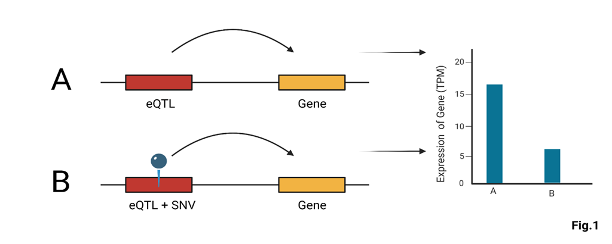
Introduction to eQTL analysis
What are eQTLs?
Expression Quantitative Trait Loci (eQTLs) are genomic loci associated with variations of downstream gene expression.
Single nucleotide variations (SNVs) in these loci can lead to divergent outcomes in the expression levels of particular genes.

Slide 5
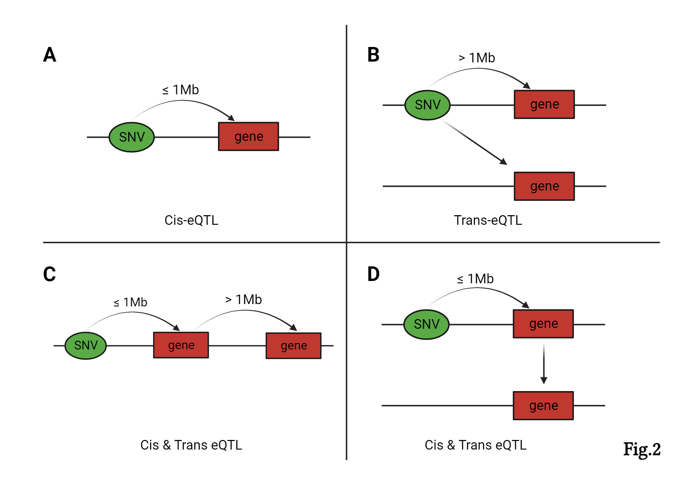
Introduction to eQTL analysis (cont.)
eQTLs can be categorized into two main classes based on their genomic locations relative to the genes they influence: Cis-eQTLs and Trans-eQTLs.
Cis-eQTLs: "on the same side" or “local.”
Located within 1 million base pairs from a gene, and affect the expression of that gene. (A, Fig.2)
Trans-eQTLs: "on the opposite side" or “distant.”
Located at a different chromosome or in the same chromosome but farther away than 1 million base pairs from the gene(s) they influence. (B, Fig.2)
Alternatively, we could also define some Trans-eQTLs as being both Cis and Trans-acting since they act on local genes which in turn act on other distant ones. (C & D, Fig.2)

Slide 6
Introduction to eQTL analysis (cont.)
eQTL analysis:
The goal of eQTL analysis is to associate single nucleotide variants (SNVs) with gene expression profiles, in order to identify regions of the genome that are associated with the expression levels of particular genes, eQTLs.
These eQTLs could then be potentially used for the development of targeted therapeutic strategies for a variety of diseases and conditions such as type-1 diabetes, bipolar disorder, and more.

Slide 7
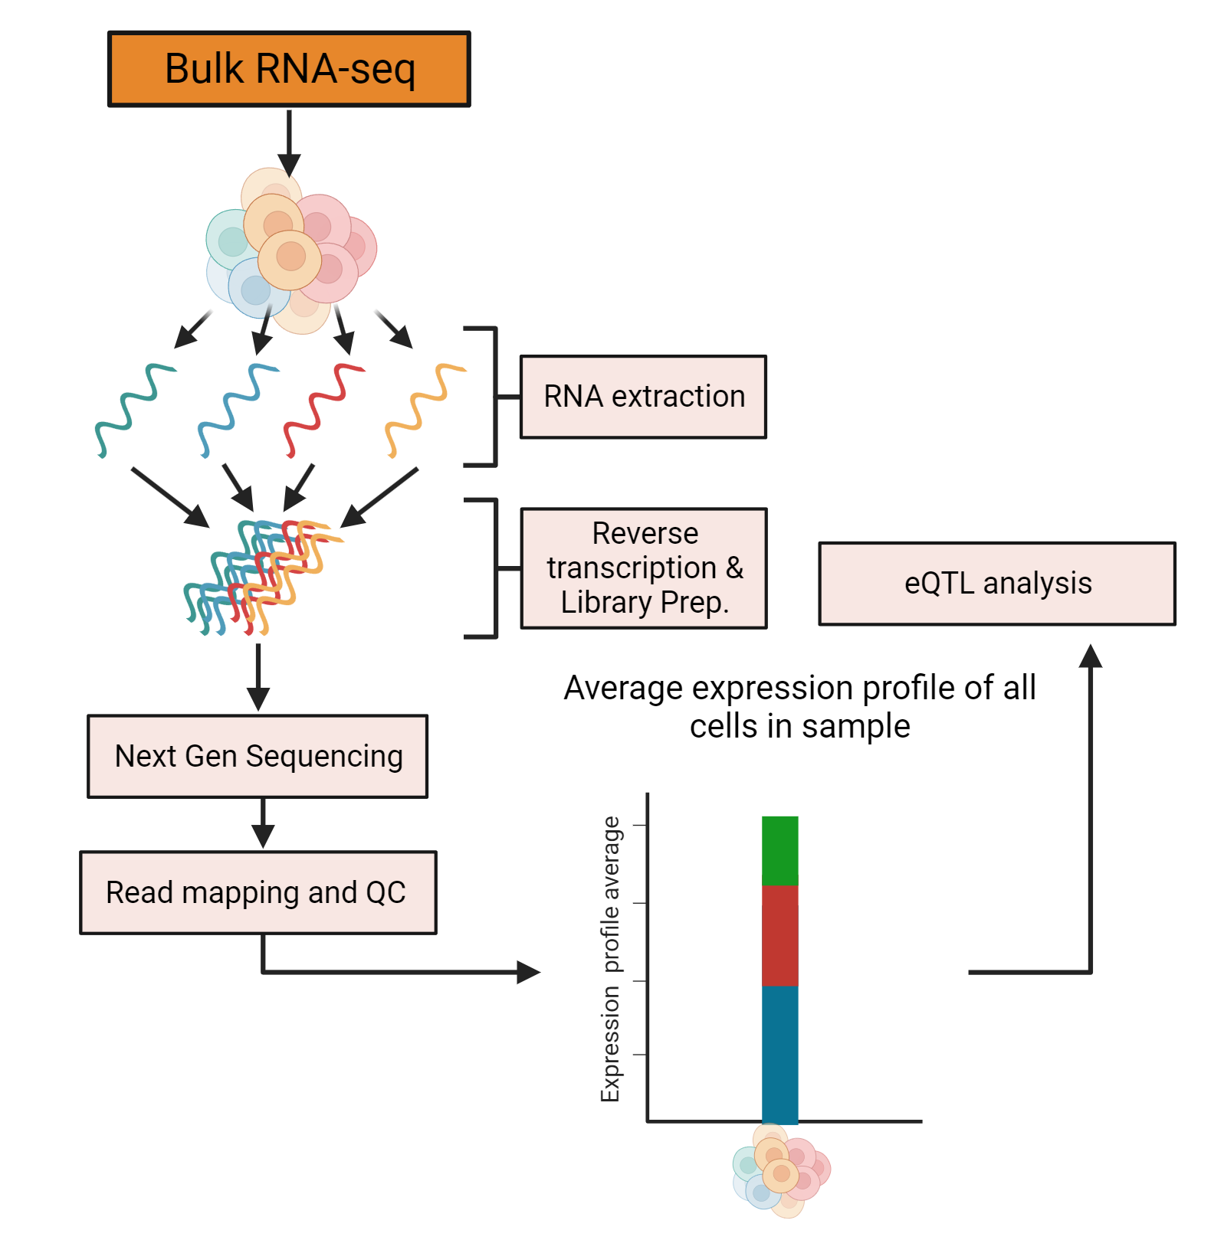
eQTL analysis: Bulk vs Single-Cell
Traditionally, eQTL analysis has been conducted on bulk RNA sequencing data, where the gene expression profile of a sample is represented as the average gene expression of all cells in that particular sample.
This approach inherently disregards the cellular heterogeneity present within tissues composed of diverse cell types, where distinct cellular subpopulations exhibit unique gene expression profiles.
Consequently, the resulting averaged expression value can obscure vital regulatory associations specific to individual cell types or states.

Slide 8
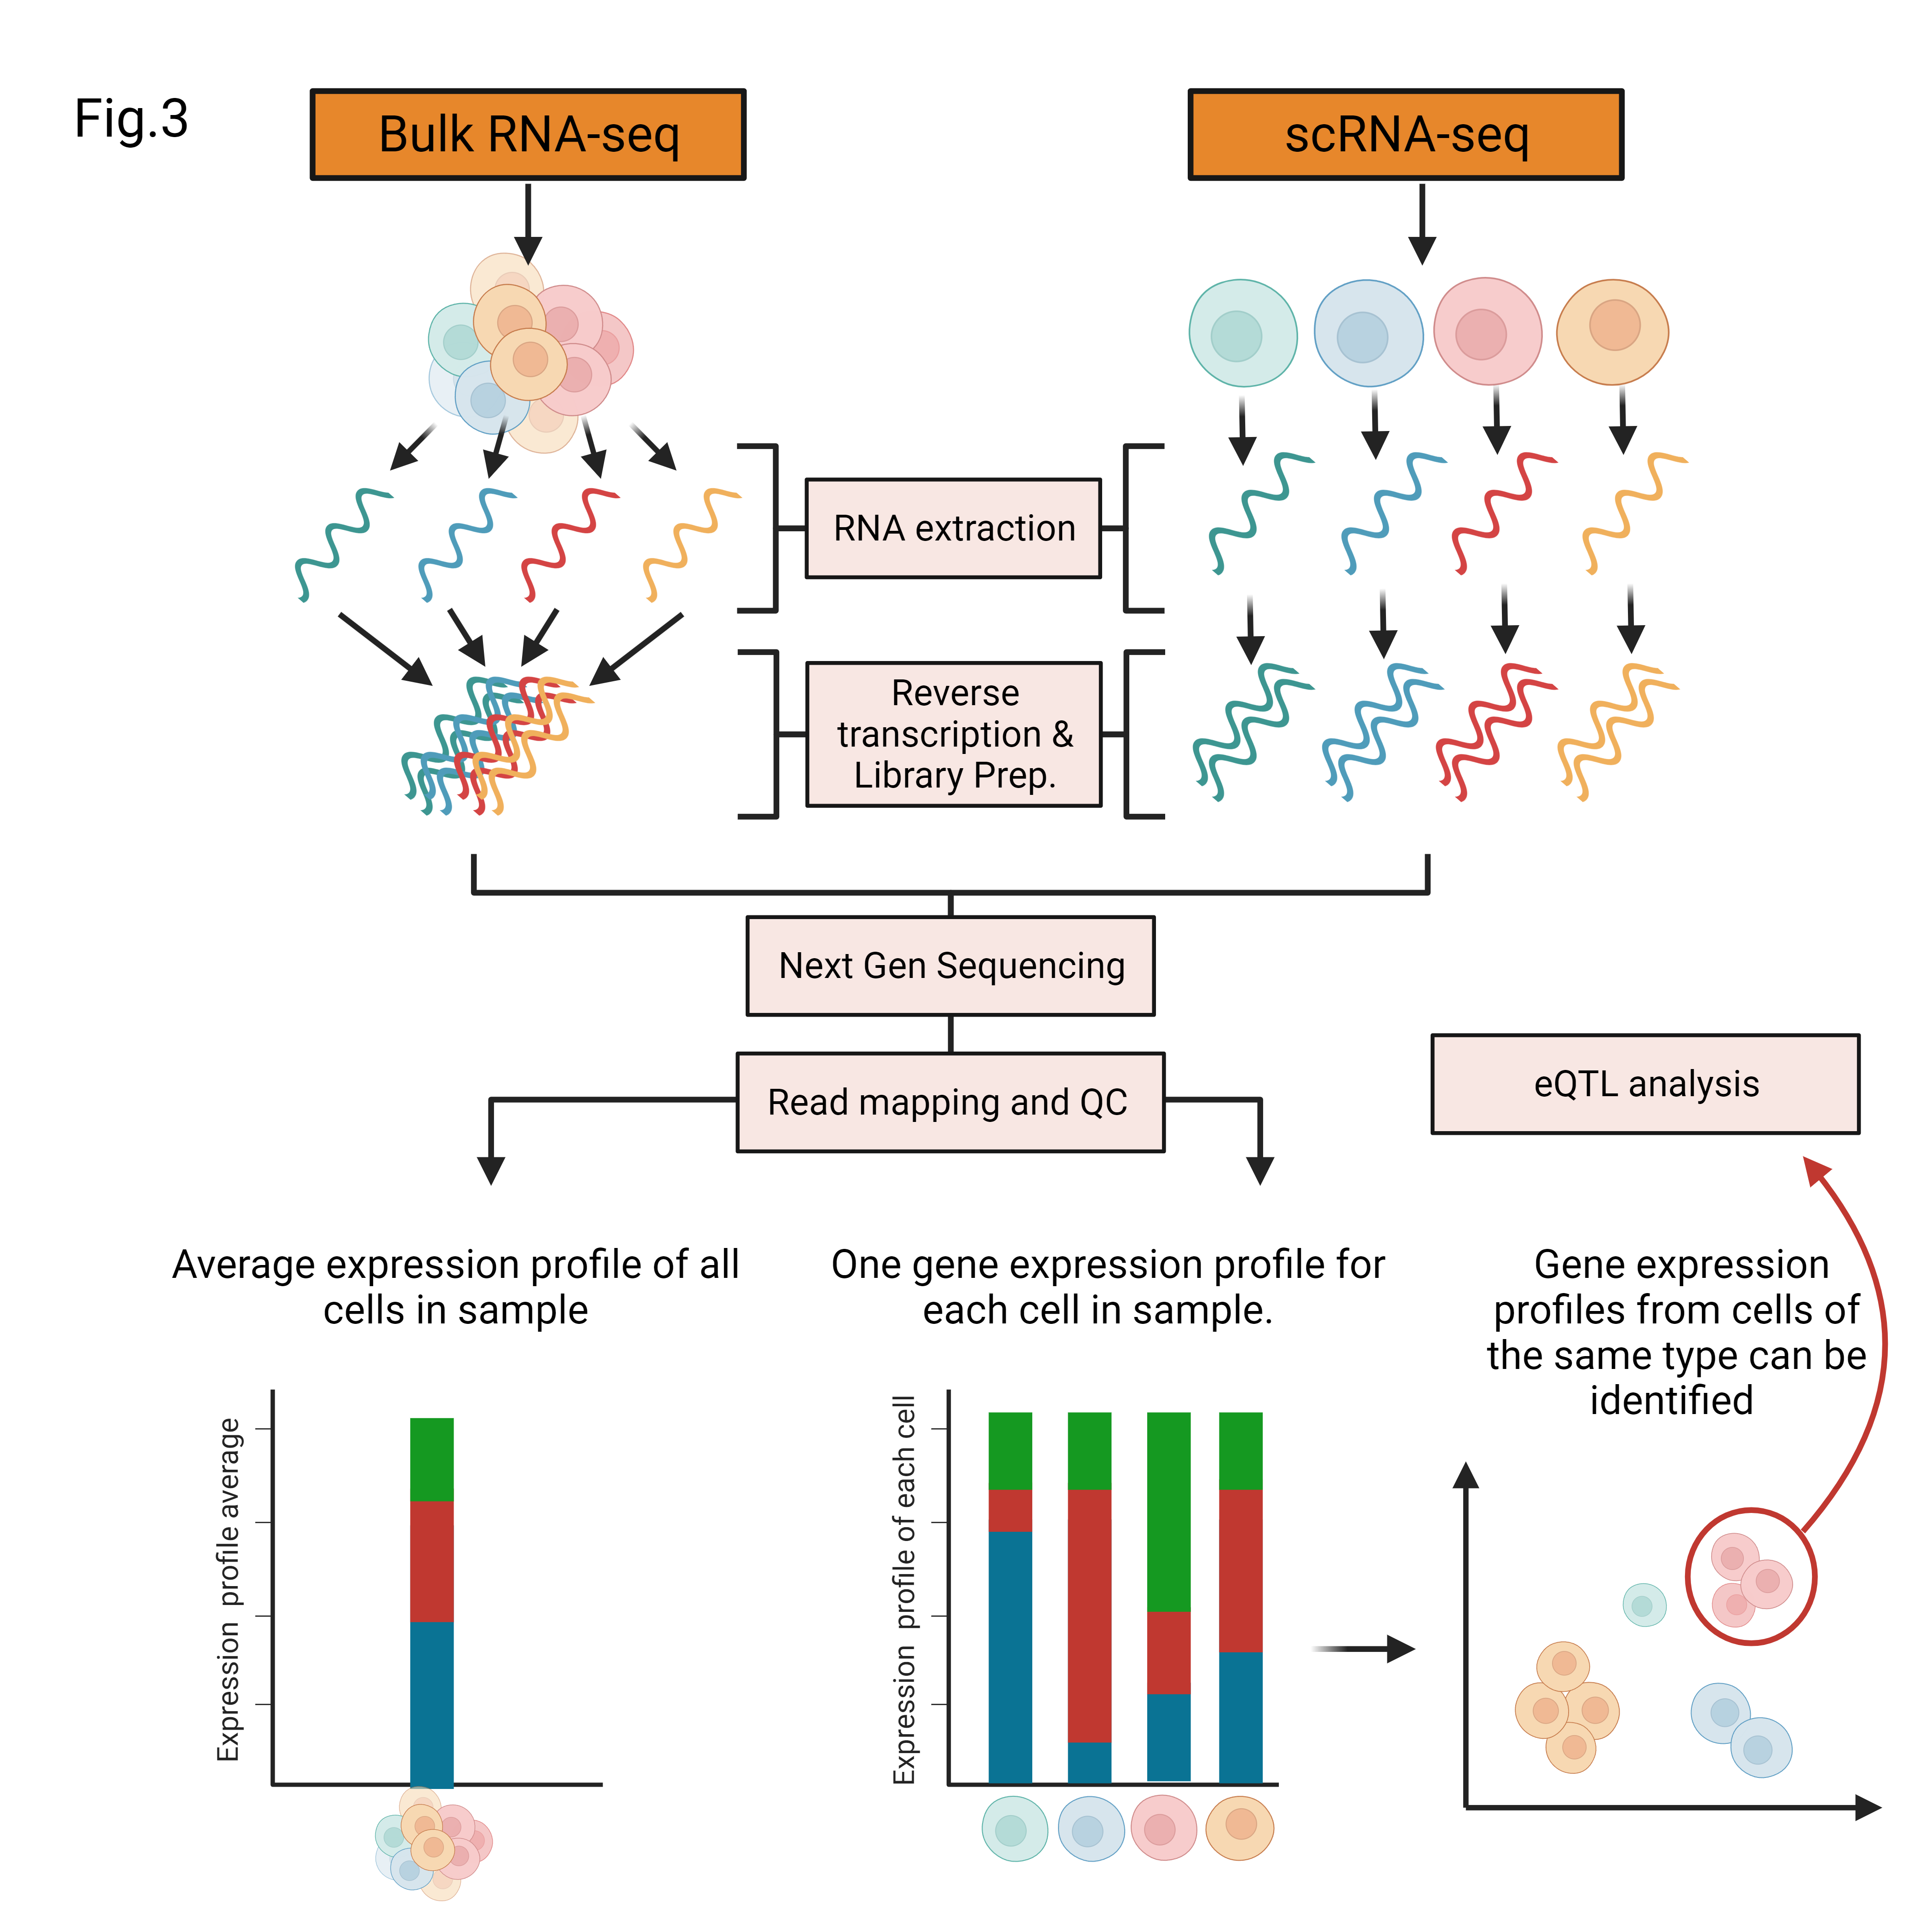
eQTL analysis: Bulk vs Single-Cell (cont.)
This deficiency in traditional eQTL analysis necessitates the adoption of single-cell RNA sequencing (scRNA-seq).
By profiling gene expression in individual cells from a sample, scRNA-Seq allows us to identify and group expression profiles of individual cells from each cell type present in a collected sample.
Facilitating the discovery of eQTLs that would be otherwise obscured when expression profiles are averaged across distinct cell populations.

Slide 9
eQTL analysis with eQTLsingle
What is eQTLsingle?
eQTLsingle is an eQTL analysis tool that allows us to detect eQTLs in cells of the same type by only using scRNA-seq data. This can be accomplished by detecting SNVs present in the scRNA-seq data in order to generate mutation profiles at the single-cell resolution.
Meaning that, we can generate both of the gene expression and mutation profiles of each cell from the RNA transcripts alone. eQTLsingle uses these profiles to detect eQTLs in the exons, coding regions of the genome, from which the RNA transcripts were generated.

Slide 10
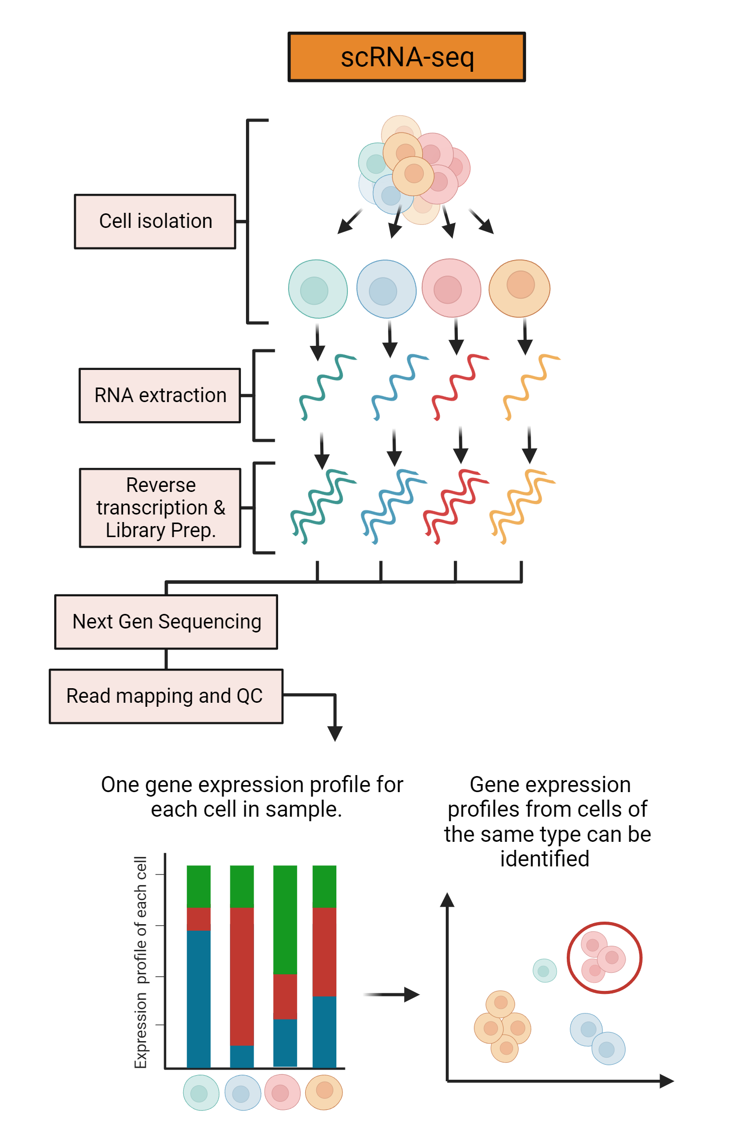
eQTL analysis with eQTLsingle (cont.)
Step 1: Data collection
Gene expression profiles can be obtained from a group of cells of the same type via isolating individual cells from a bulk sample, sequencing their RNA, and comparing the obtained gene expression profiles.
We can assume cells with similar expression profiles to be of the same cell type.

Slide 11
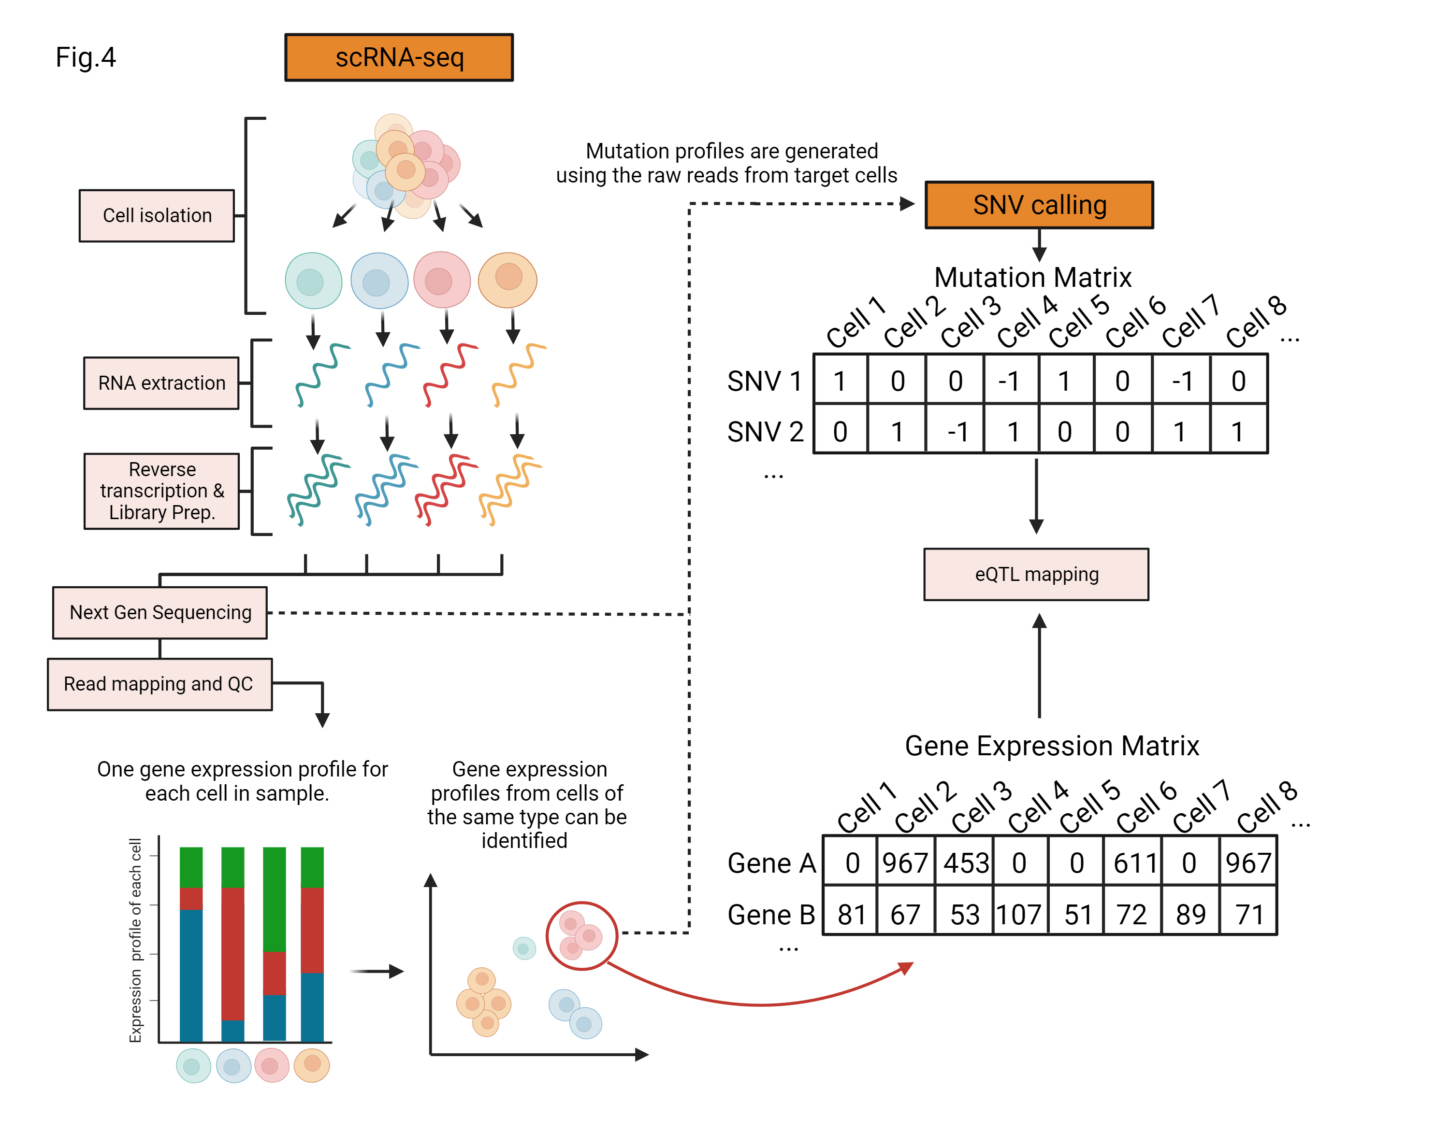
eQTL analysis with eQTLsingle (cont.)
Step 2: Data preprocessing
eQTLsingle requires two inputs: A gene expression matrix and a mutation (SNV) matrix.
Generating the gene expression matrix:
The final form of the obtained gene expression profiles is a gene expression matrix (gene x cell), rownames of this matrix are gene ids, colnames are cell ids. The individual elements of this matrix represent the number of counts of a particular gene X in a particular cell Y.

Slide 12
eQTL analysis with eQTLsingle (cont.)
Step 2: Data preprocessing (cont.)
Generating the mutation matrix:
The final form of the mutation profiles is a mutation matrix (SNV x cells), rownames of this matrix are SNV ids, colnames are Cell ids. The individual elements of this matrix represent if a particular cell X has a particular SNV Y.
These elements are divided into three groups: the reference group (0), the alternate group (1), and the insufficient information group (-1).

Slide 13
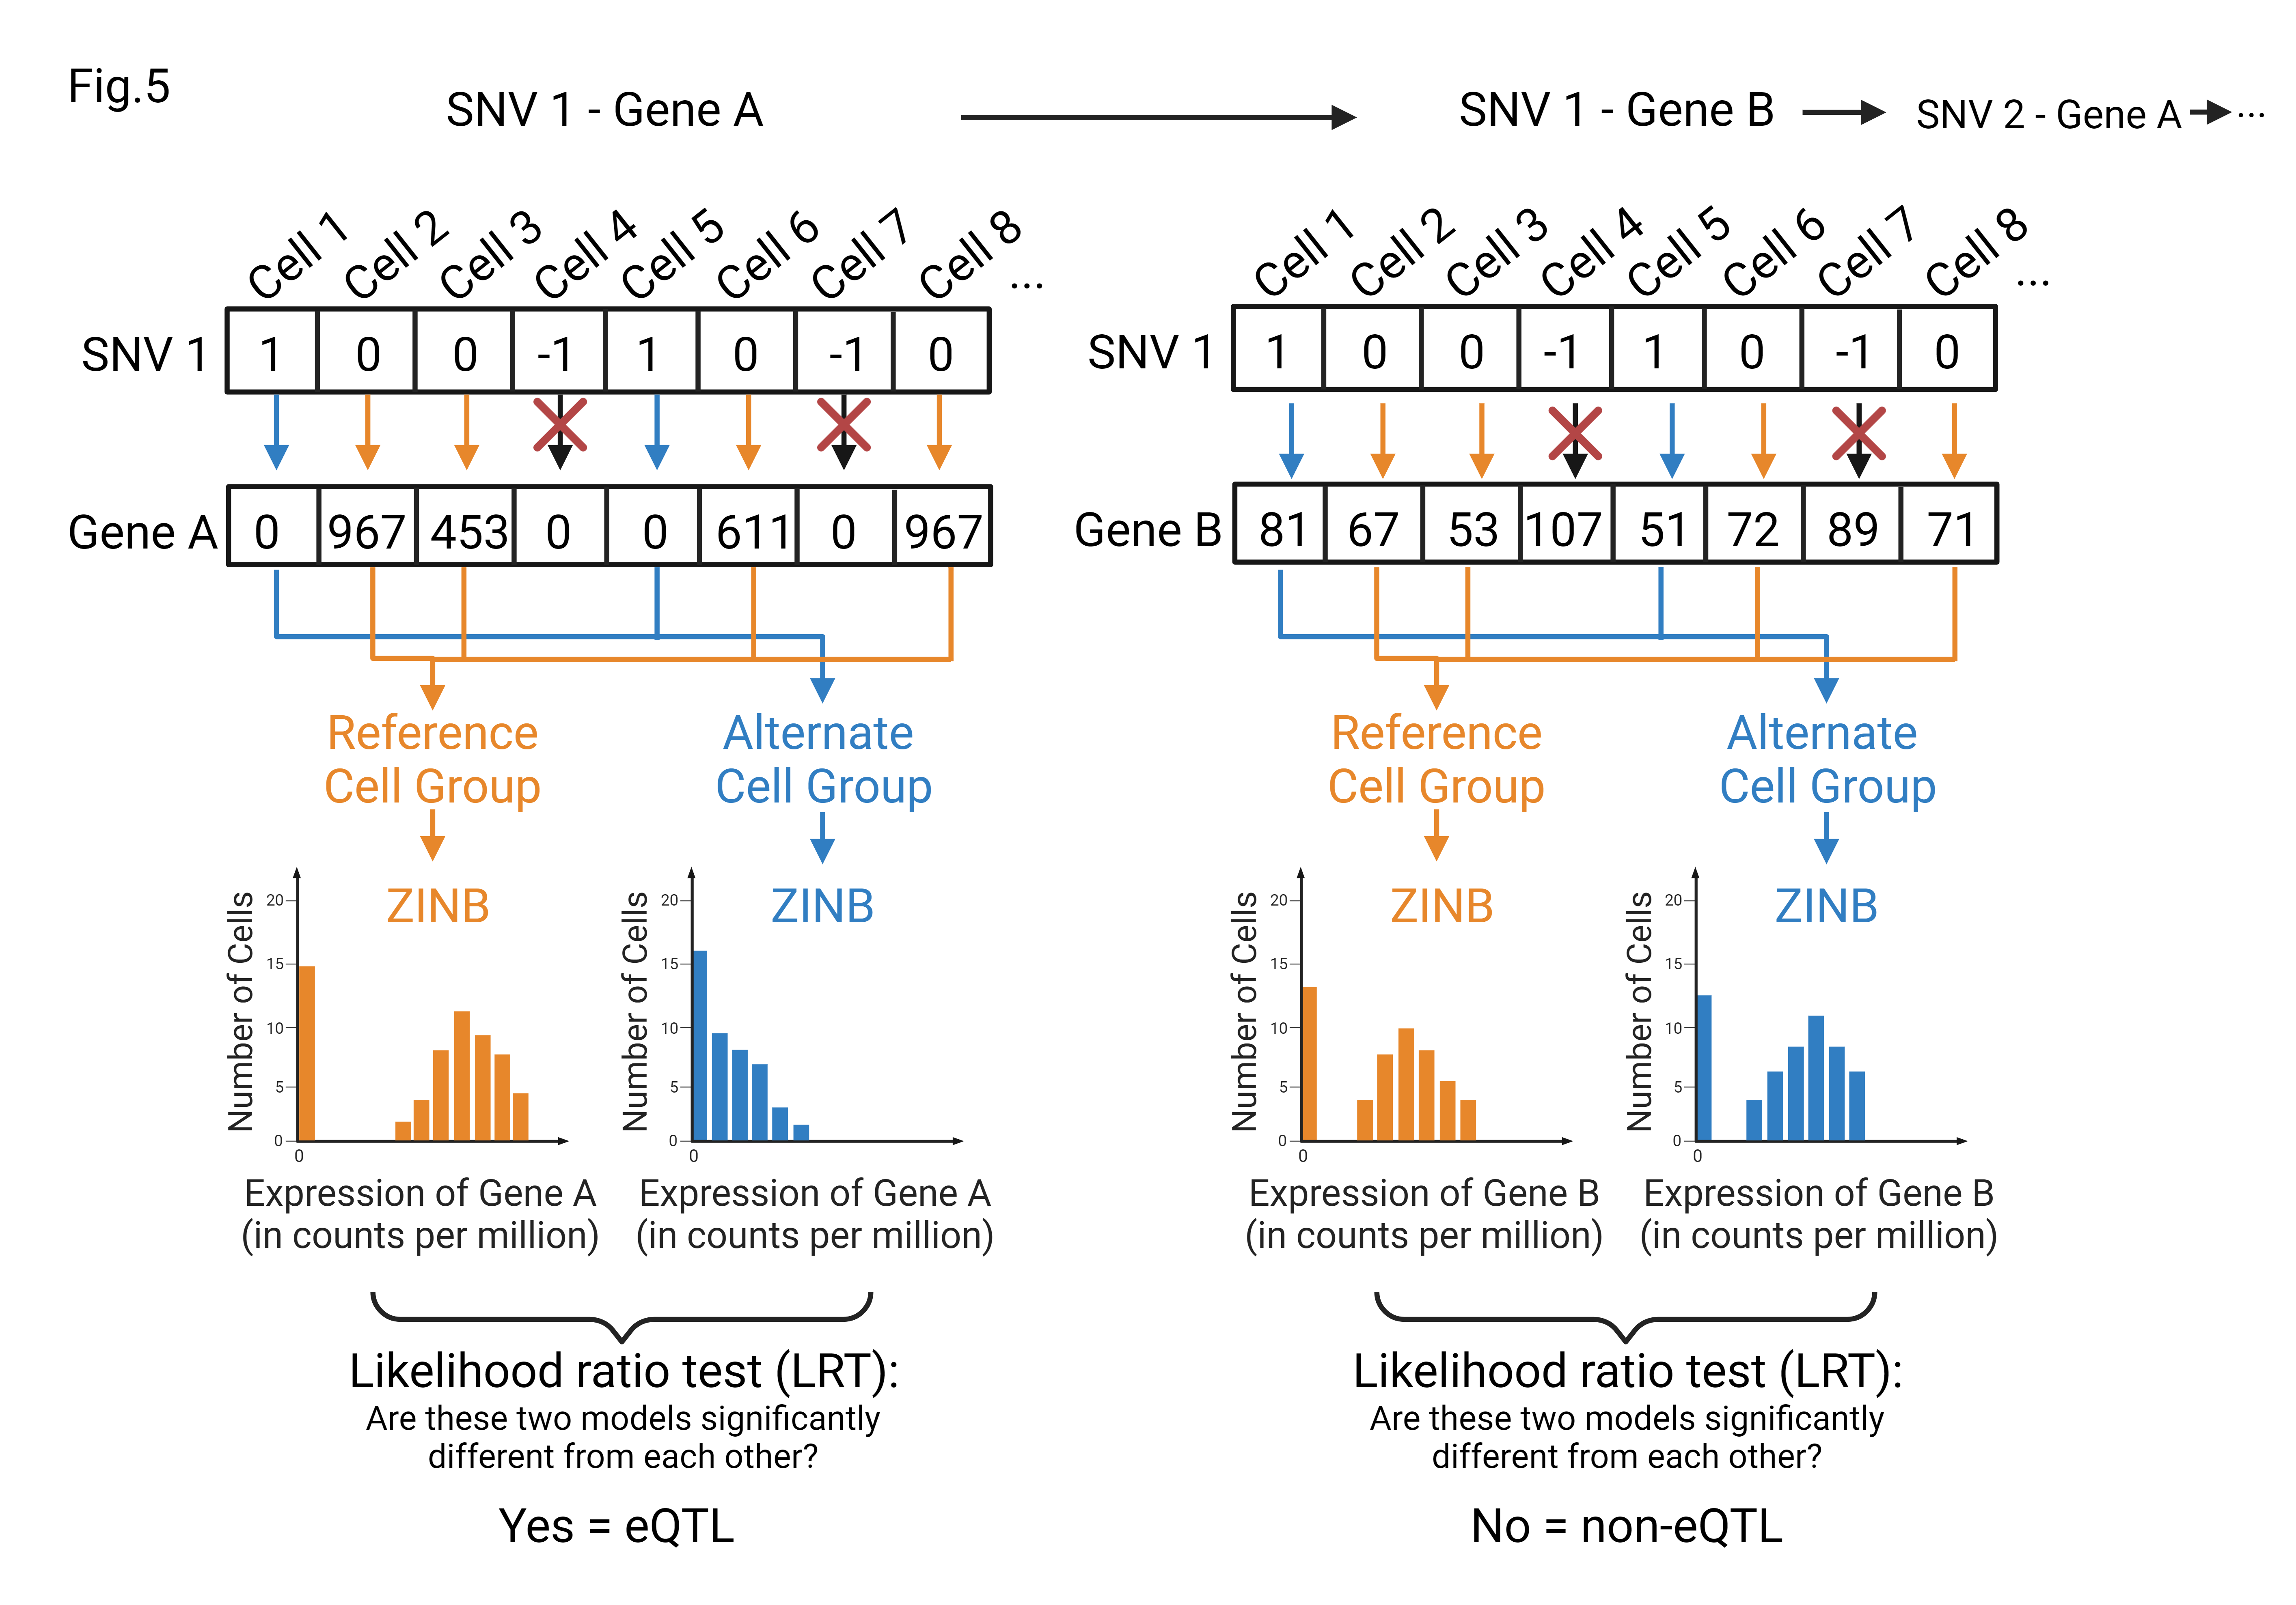
eQTL analysis with eQTLsingle (cont.)
Step 3: eQTL mapping
eQTLsingle goes through each detected SNV in the mutation matrix and looks for possible eQTL associations on all genes in the gene expression matrix.
It can accomplish this by dividing the cells into the aforementioned reference and alternate groups of a particular SNV and gene pair.

Slide 14
eQTL analysis with eQTLsingle (cont.)
Step 3: eQTL mapping (cont.)
eQTLsingle then builds a zero inflated negative binomial model (ZINB), for the gene expression level of a particular gene in each group of cells.
Zero inflated = most genes have an expression level of zero (not expressed) in each particular cell of any given cell type.
Negative binomial = a model widely used for modeling RNA-seq data.

Slide 15
eQTL analysis with eQTLsingle (cont.)
Step 3: eQTL mapping (cont.)
Once the ZINB model has been generated for each group, eQTLsigle uses a likelihood ratio test (LRT) to compare the models of the two groups.
The genomic location of the SNV is identified as an eQTL for the target gene if the test finds a significant difference between the two models.

Slide 16
Limitations of only using scRNA-seq
Generating both gene expression and mutation profiles from each cell by using only scRNA-seq data comes with some limitations:
Raw reads we collect from RNA-seq data only have genetic information from exons, SNVs present in introns (which represent around 97.06% of the entire genome) are not taken into account.
SNVs present in lowly expressed genes cannot be detected during the reverse transcription and cDNA amplification steps of scRNA-seq. These SNVs are also not taken into account.

Slide 17
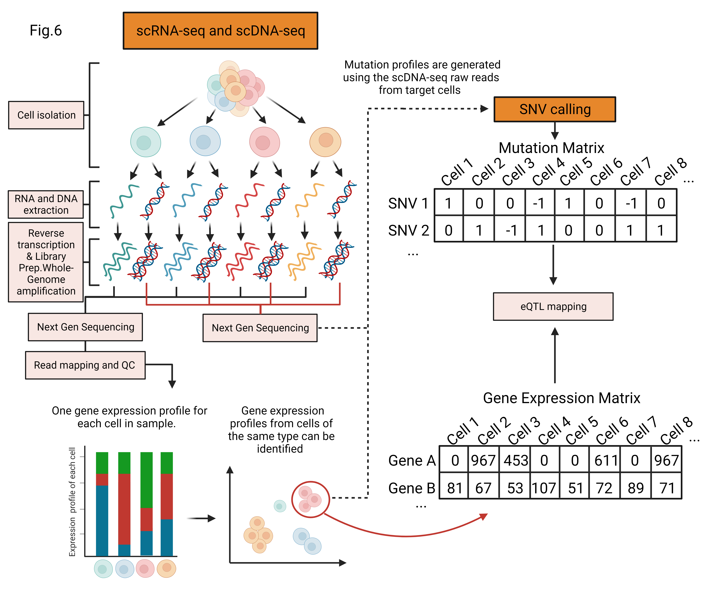
Integrating scDNA-seq to address limitations
The ideal solution to both of these limitations would be for single-cell-type eQTL studies to sequence both the genome and transcriptome for each single-cell simultaneously.
By incorporating the scDNA-seq workflow after the cell isolation stage of the previously mentioned scRNA-Seq workflow, we could generate the gene expression matrix from scRNA-seq data and the Mutation matrix from the scDNA-seq data.
This would address both limitations while preserving single-cell resolution.

Slide 18
Conclusion and Future Directions
In this paper, we reviewed the methods used for detecting eQTLs in eQTLsingle, identified the inherent limitations of only using scRNA-seq data for eQTLs, and proposed possible solutions to these limitations.
The next logical step when it comes to future research objectives would be to identify novel paired-sequencing methods and technologies in order to simultaneously sequence both DNA and RNA from single cells, and to review them in depth.
Doing so could enable researchers to have the tools needed to resolve the previously mentioned limitations and discover eQTLs across the entire genome while preserving single-cell resolution.

Slide 19
Questions?

Slide 20
Thank you!

